Slide 1
Digital Portfolio
STUDENT NAME : Venkatesan D
REGISTER NO AND NMID : 222402518/asnum161222402518
DEPARTMENT : BSc.Computer science
COLLEGE: COLLEGE/ UNIVERSITY : Prince Shri Venkateswara Arts
And Science College/Madras University

Slide 2
PROJECT TITLE :
Digital Portfolio

Slide 3


AGENDA
Problem Statement
Project Overview
End Users
Tools and Technologies
Portfolio design and Layout
Features and Functionality
Results and Screenshots
Conclusion
Github Link
3/21/2024 Annual Review

Slide 4

PROBLEM STATEMENT
Showcasing skills and projects through static resumes is limiting, creating the need for a dynamic digital portfolio.

Slide 5

PROJECT OVERVIEW
My digital portfolio is a space to present who I am, what I do, and the work I’m proud of. It’s designed to make it easy for others to connect with my skills and explore my journey.

Slide 6

WHO ARE THE END USERS?
Potential Employers/Recruiters – to evaluate skills, projects, and experience.
Clients/Collaborators – to explore work samples before partnerships.
Peers/Community – for networking, learning, and inspiration.

Slide 7

TOOLS AND TECHNIQUES
Vs Code - Code Editor
HTML – Structure purpose
CSS – Styling purpose
Javascript – Interactive purpose
Github – Hosting Platform

Slide 8
POTFOLIO DESIGN AND LAYOUT
Layouts Included:
Home
About
Skills
Contact me part
Form validation
‹#›

Slide 9
FEATURES AND FUNCTIONALITY
Contains Navigation Bar
Has Smooth Scrolling feature
Pop up animations for containers and buttons
Glowing effect for conatiners and button
Has a Form validation
Has Day and Night Theme

Slide 10
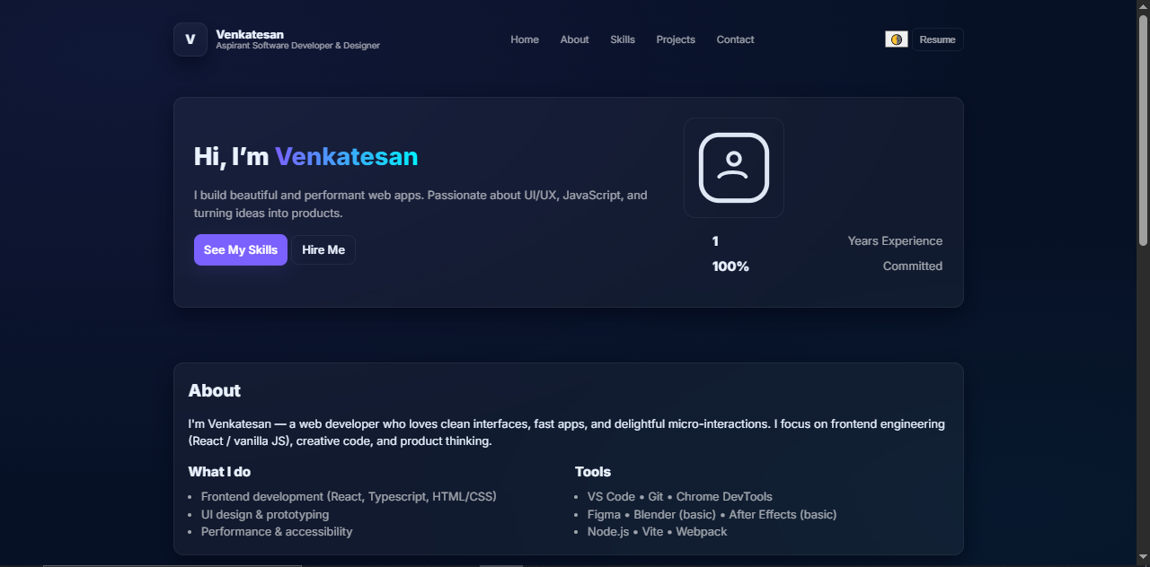

RESULTS AND SCREENSHOTS
3/21/2024 Annual Review
‹#›

Slide 11
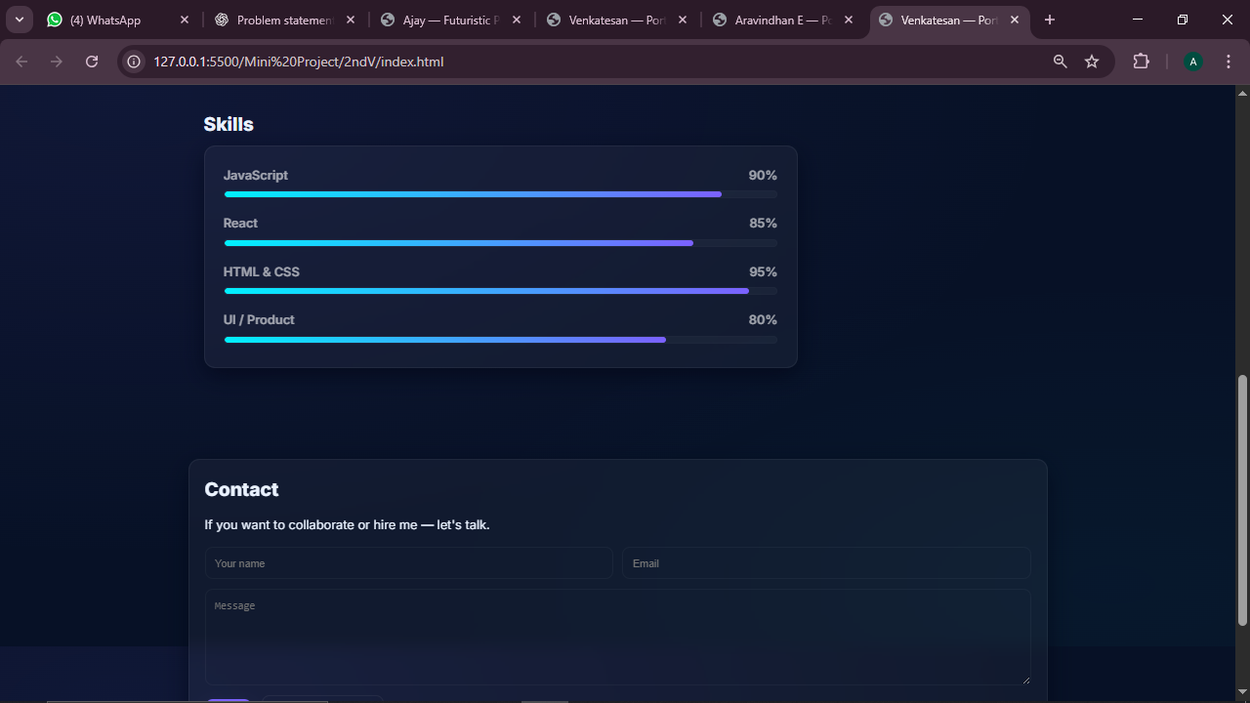

Slide 12
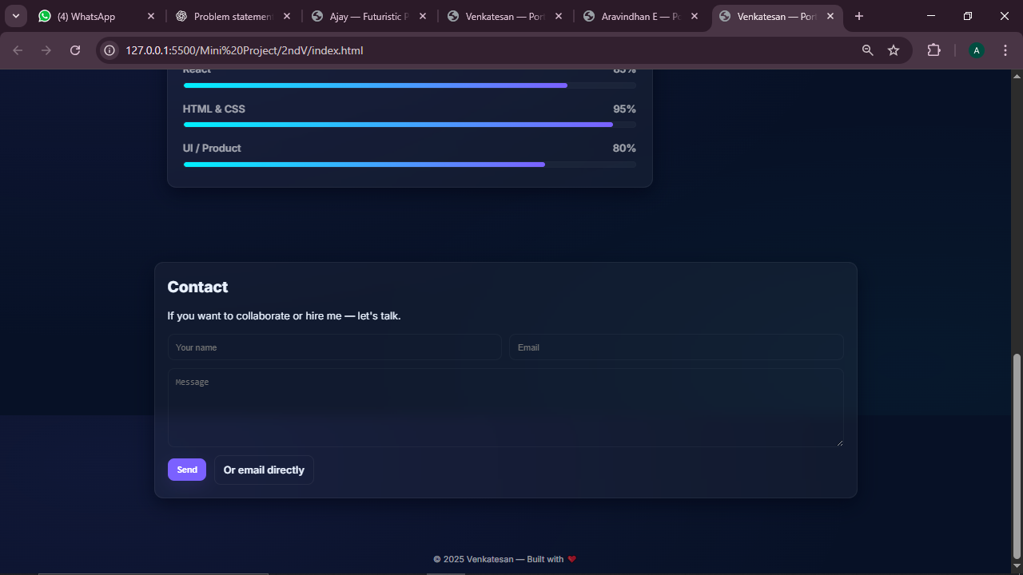

Slide 13
CONCLUSION
A digital portfolio is more than just a resume — it’s a creative way to showcase our skills..It helps me stand out, connect with opportunities, and grow in today’s digital world.
‹#›

Slide 14
GitHub Link:
https://d-venkatesan-07.github.io/TNDSC-FWD-DP/

